Slide 1


Lecture 29
Produced by Dr. Worldwide
Welcome to the 305
~
~

Slide 2

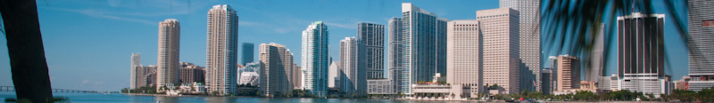
Stochastic Simulation
Simulation is used to “simulate” the operations of various kinds of real-world systems or processes with the aid of a computer
We make assumptions about how a system works
These assumptions constitute a model
Models are used to gain some understanding of how a system behaves
In simple models, we can use analytical (mathematical) methods to obtain exact information on questions of interest
In complex models, use simulation to evaluate the model numerically

Slide 3
Monte Carlo Process
Large proportion of applications of simulations are for probabilistic models
Monte Carlo is a technique for selecting numbers randomly from a probability distribution
Monte Carlo is not a simulation model, but a mathematical process used within a simulation
Monte Carlo simulation can also be thought of as multiple probability simulation
Read Link 1 on course website for more description about Monte Carlo

Slide 4
Random Number Generator
To run a simulation, we may need “observations” from a random process
If we “know” the distribution of these observations, we might be able to generate them artificially
Historically, random numbers have been generated physically
Throwing dice
Dealing cards
Drawing balls from urns
Not until mid 1950’s where electronic random number generators were used
Two kinds of random number generators: physical and numerical
Computer are equipped with numerical random number generators

Slide 5
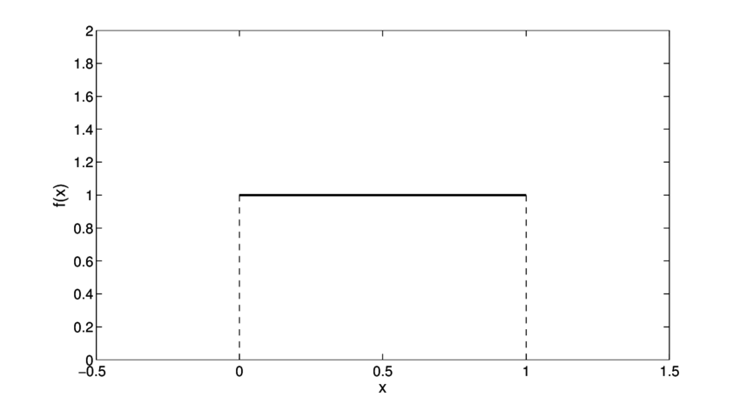
Random Number Generator
Q: Other than my teaching, is anything truly random?
Numerical random number generators are not really random
The most basic type of random numbers that we can artificially generate are from the Uniform[0,1] distribution where numbers between 0 and 1 are equally likely
RAND() function in Excel samples from this distribution
We can generate random numbers from any other
distribution from the RAND() function
Read Link 2 on course website for more description
about RAND()

Slide 6
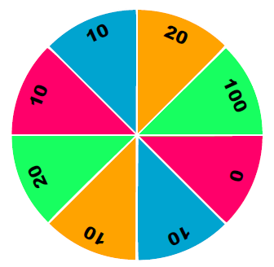
Spinning a Wheel
Suppose we want to simulate the result of spinning a wheel of fortune
No physical version of the wheel, but can generate random uniform numbers
Q: How can we use RAND() to “spin” the wheel?

Slide 7
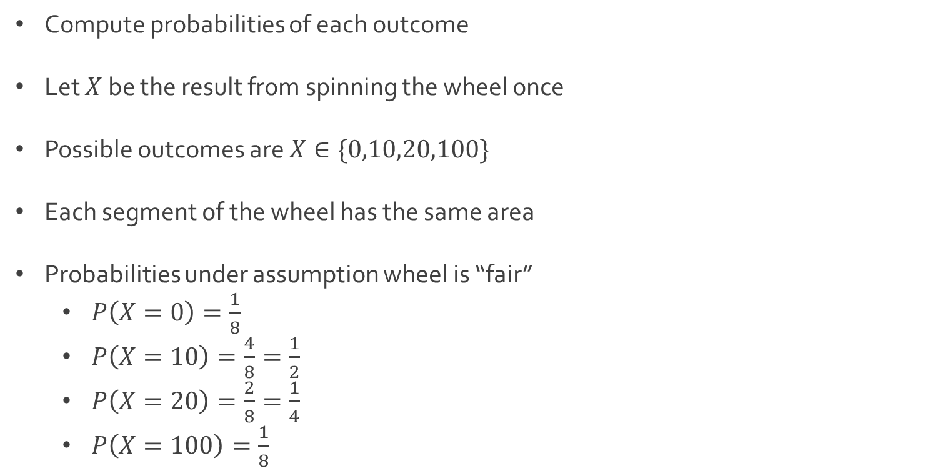
Spinning a Wheel
Compute probabilities of each outcome
Let $X$ be the result from spinning the wheel once
Possible outcomes are $X∈\{0,10,20,100\}$
Each segment of the wheel has the same area
Probabilities under assumption wheel is “fair”
$P\left(X=0\right)=\frac{1}{8}$
$P\left(X=10\right)=\frac{4}{8}=\frac{1}{2}$
$P\left(X=20\right)=\frac{2}{8}=\frac{1}{4}$
$P\left(X=100\right)=\frac{1}{8}$

Slide 8
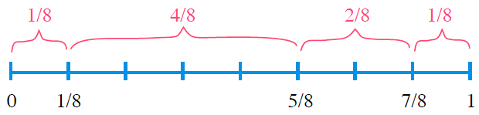
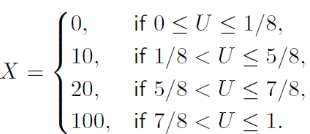
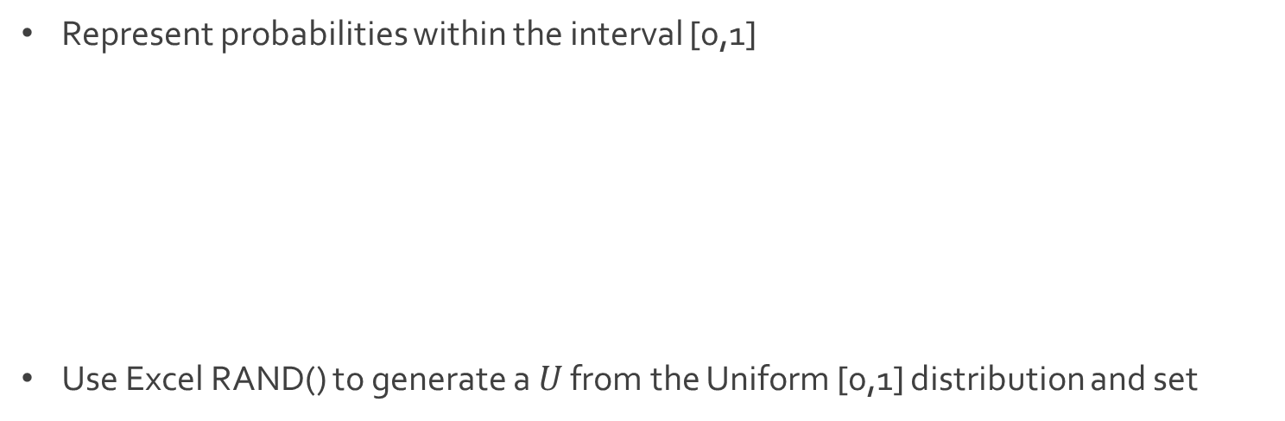
Spinning a Wheel
Represent probabilities within the interval [0,1]
Use Excel RAND() to generate a $U$ from the Uniform [0,1] distribution and set

Slide 9
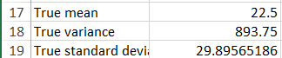
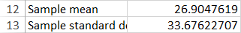
Spinning a Wheel
Download SpinWheel.xlsx from link Sheet 1 on course website
When we use the RAND() function repeatedly, the random numbers generated are independent of each other
We can use Excel to simulate as many spins of the wheel as we want
Random sample located in cells E6:E47
We are simulating 42 spins of this wheel
Compare theoretical mean and standard deviation to sample statistics

Slide 10
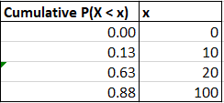
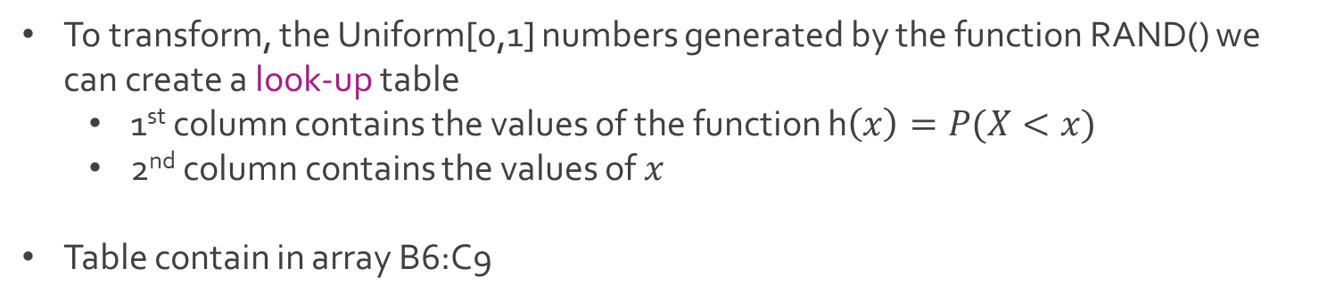
Spinning a Wheel
To transform, the Uniform[0,1] numbers generated by the function RAND() we can create a look-up table
1st column contains the values of the function h$\left(x\right)=P(X<x)$
2nd column contains the values of $x$
Table contain in array B6:C9

Slide 12
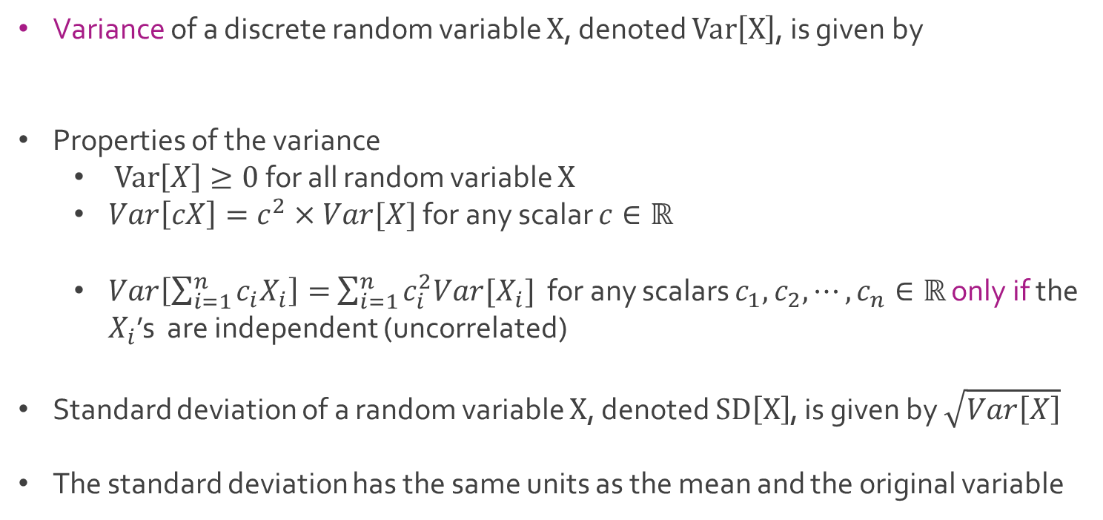
Discrete Random Variable
Variance of a discrete random variable $X$, denoted $Var\left[X\right]$, is given by
Properties of the variance
$Var\left[X\right]≥0$ for all random variable $X$
$Var\left[cX\right]=c^{2}×Var[X]$ for any scalar $c∈ℝ$
$Var\left[\sum_{i=1}^{n}{c_{i}X_{i}}\right]=$ $\sum_{i=1}^{n}{c_{i}^{2}{Var[X}_{i}]}$ for any scalars $c_{1},c_{2}, ⋯,c_{n}∈ℝ$ only if the $X_{i}$’s are independent (uncorrelated)
Standard deviation of a random variable $X$, denoted $SD\left[X\right]$, is given by $\sqrt{Var\left[X\right]}$
The standard deviation has the same units as the mean and the original variable
$$Var\left[X\right]=E\left[{\left(X−E\left[X\right]\right)}^{2}\right]=E\left[X^{2}\right]−{\left(E\left[X\right]\right)}^{2}$$

Slide 13
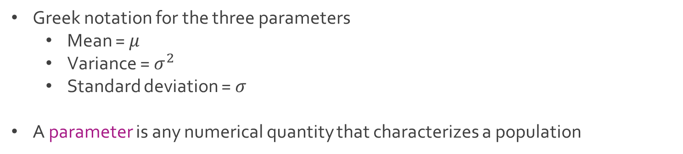
Discrete Random Variable
Greek notation for the three parameters
Mean = $μ$
Variance = $σ^{2}$
Standard deviation = $σ$
A parameter is any numerical quantity that characterizes a population

Slide 14
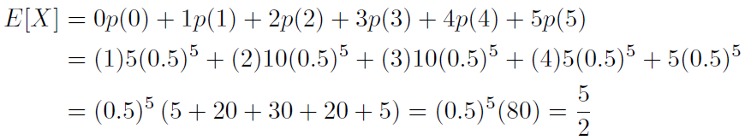
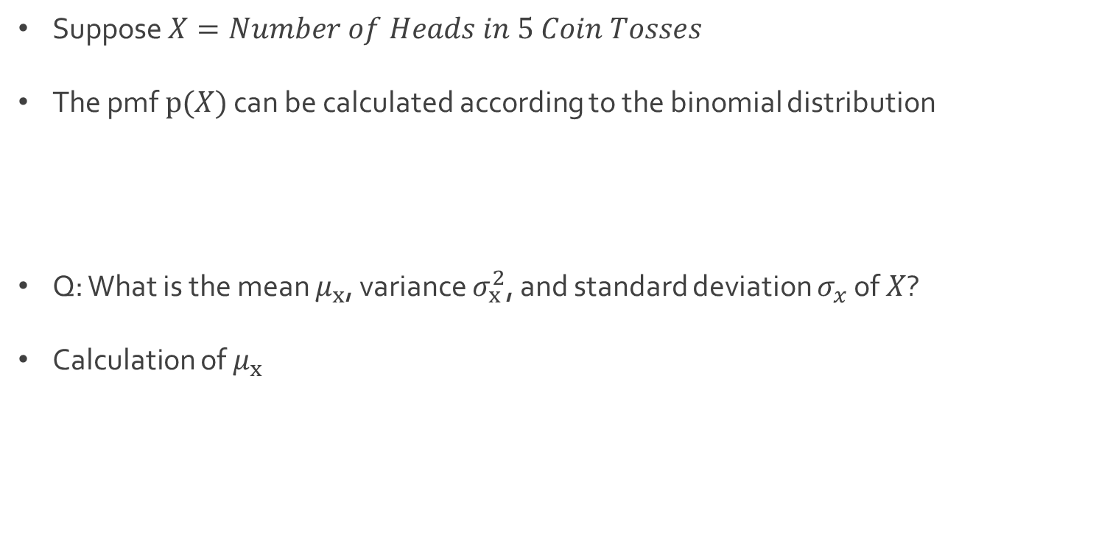
Ex: Tossing Coin
Suppose $X=Number of Heads in 5 Coin Tosses$
The pmf $p(X)$ can be calculated according to the binomial distribution
Q: What is the mean $μ_{x}$, variance $σ_{x}^{2}$, and standard deviation $σ_{x}$ of $X$?
Calculation of $μ_{x}$

Slide 15
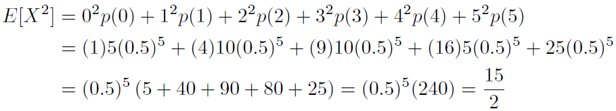
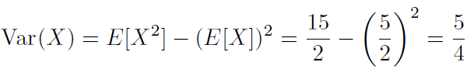
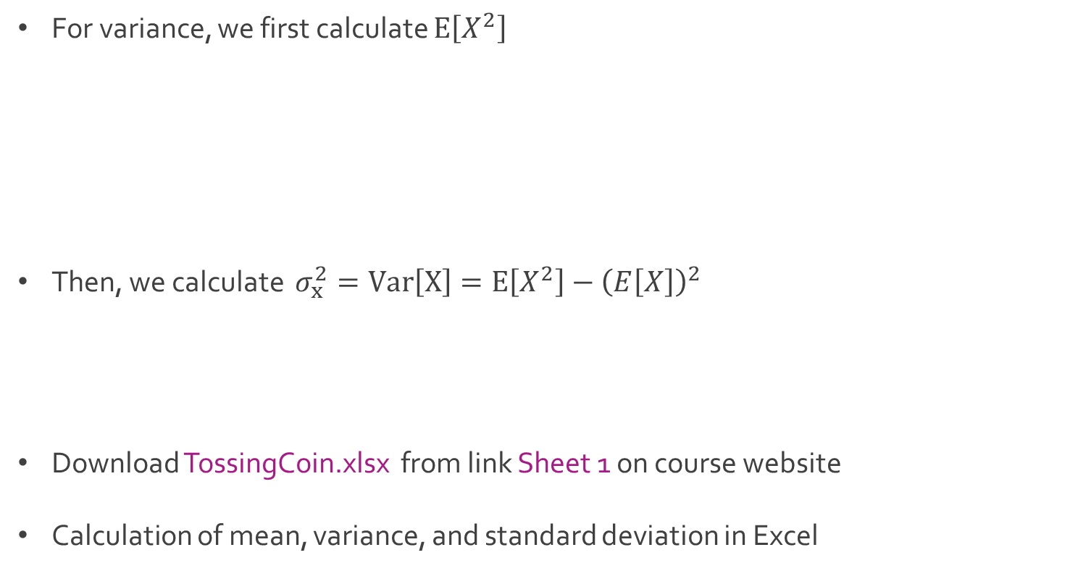
Ex: Tossing Coin
For variance, we first calculate $E\left[X^{2}\right]$
Then, we calculate $σ_{x}^{2}=Var\left[X\right]=E\left[X^{2}\right]−{\left(E\left[X\right]\right)}^{2}$
Download TossingCoin.xlsx from link Sheet 1 on course website
Calculation of mean, variance, and standard deviation in Excel

Slide 16
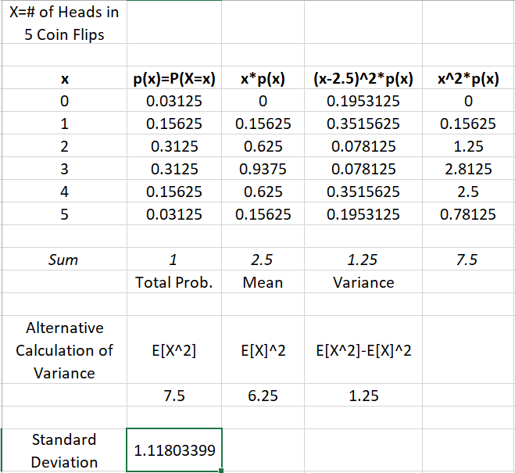
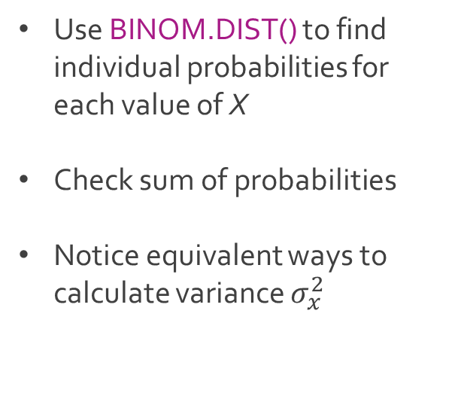
Ex: Tossing Coin
Use BINOM.DIST() to find individual probabilities for each value of X
Check sum of probabilities
Notice equivalent ways to calculate variance $σ_{x}^{2}$

Slide 17
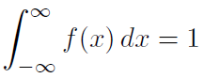
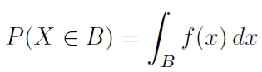
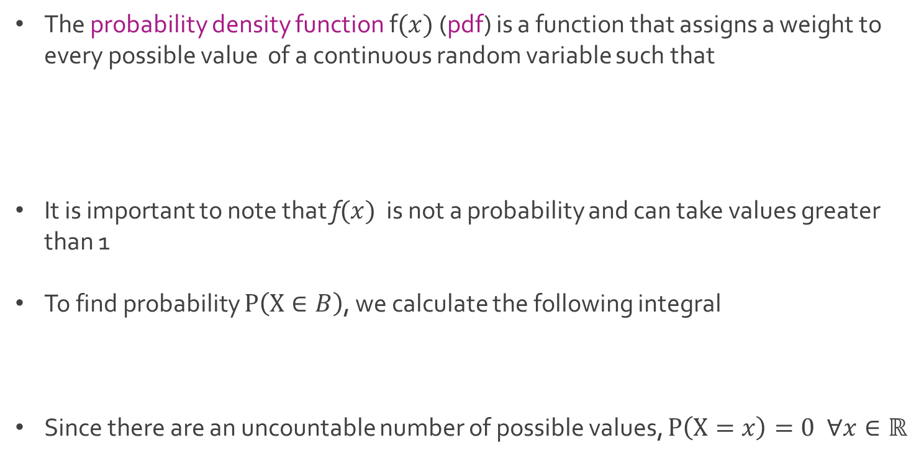
Continuous Random Variable
The probability density function f$(x)$ (pdf) is a function that assigns a weight to every possible value of a continuous random variable such that
It is important to note that f$(x)$ is not a probability and can take values greater than 1
To find probability $P\left(X∈B\right)$, we calculate the following integral
Since there are an uncountable number of possible values, $P\left(X=x\right)=0 ∀x∈ℝ$

Slide 18
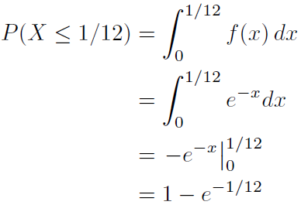
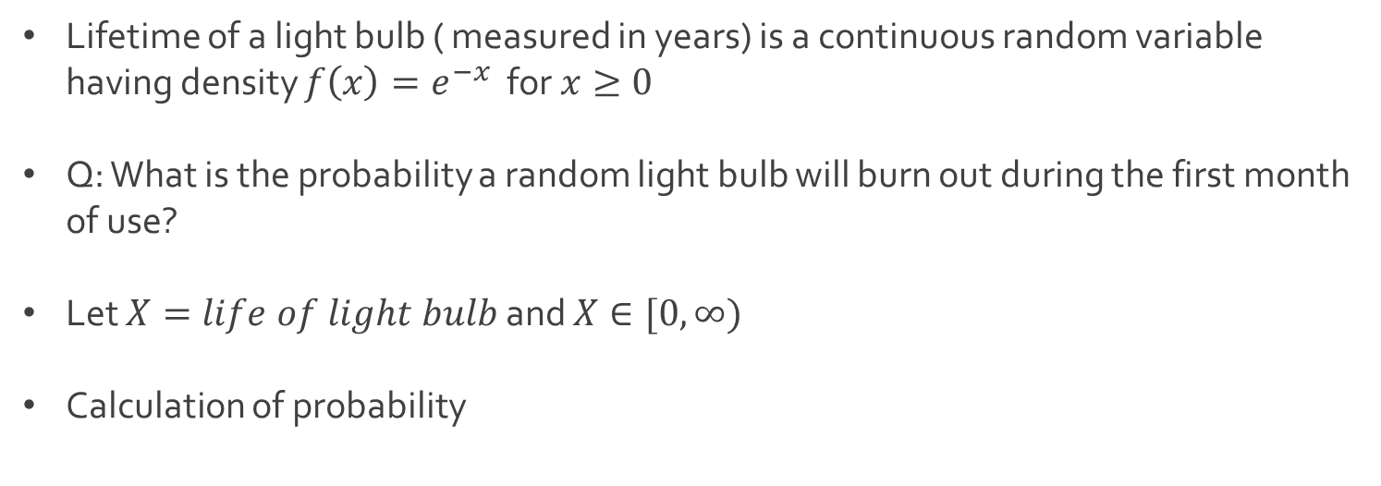
Ex: Light Bulb Lifespan
Lifetime of a light bulb ( measured in years) is a continuous random variable having density $f\left(x\right)=e^{−x}$ for $x≥0$
Q: What is the probability a random light bulb will burn out during the first month of use?
Let $X=life of light bulb$ and $X∈[0,∞)$
Calculation of probability

Slide 19
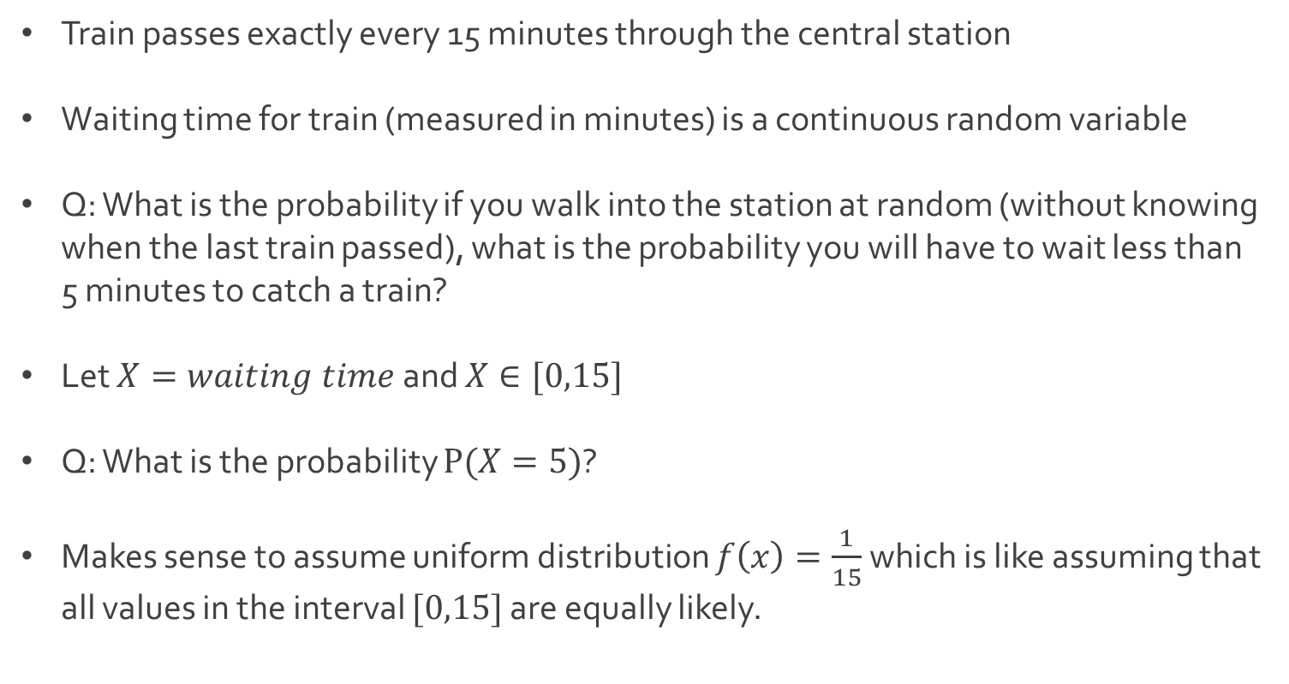
Ex: Waiting Time
Train passes exactly every 15 minutes through the central station
Waiting time for train (measured in minutes) is a continuous random variable
Q: What is the probability if you walk into the station at random (without knowing when the last train passed), what is the probability you will have to wait less than 5 minutes to catch a train?
Let $X=waiting time$and $X∈[0,15]$
Q: What is the probability $P(X=5)$?
Makes sense to assume uniform distribution $f\left(x\right)=\frac{1}{15}$ which is like assuming that all values in the interval $[0,15]$ are equally likely.

Slide 20
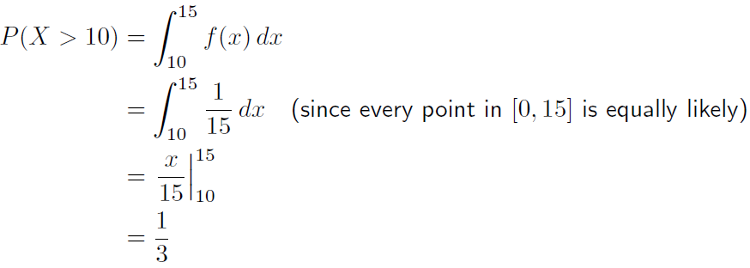
Ex: Waiting Time
Calculation of probability

Slide 21
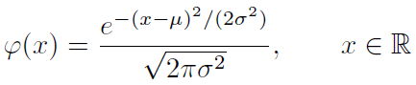
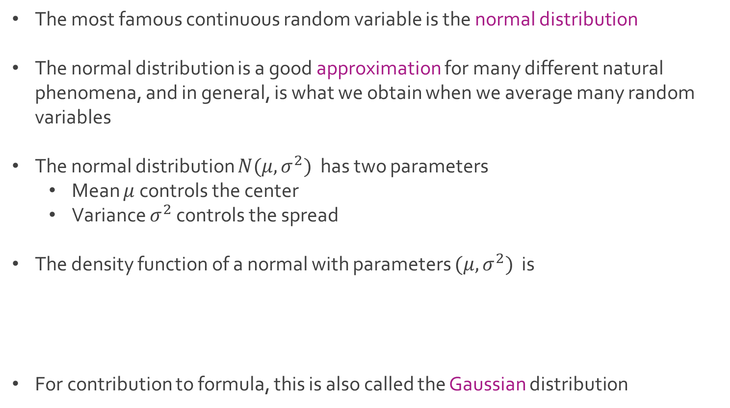
Normal Distribution
The most famous continuous random variable is the normal distribution
The normal distribution is a good approximation for many different natural phenomena, and in general, is what we obtain when we average many random variables
The normal distribution $N(μ,σ^{2})$ has two parameters
Mean $μ$ controls the center
Variance $σ^{2}$ controls the spread
The density function of a normal with parameters $(μ,σ^{2})$ is
For contribution to formula, this is also called the Gaussian distribution

Slide 22
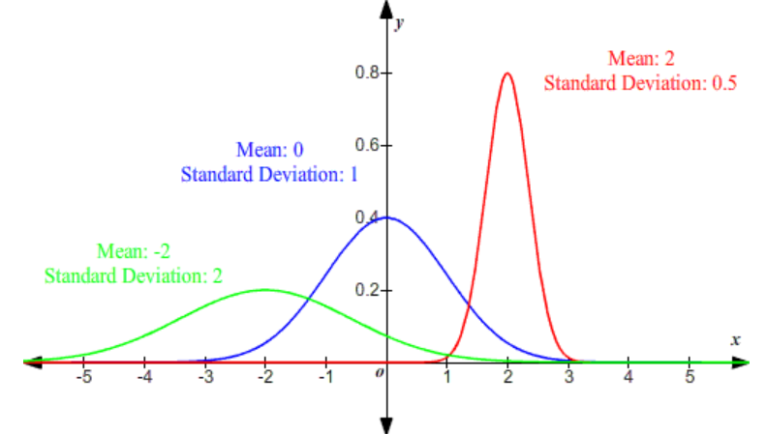
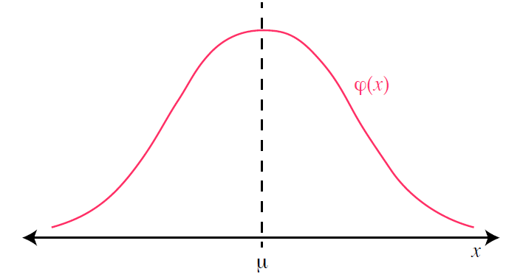
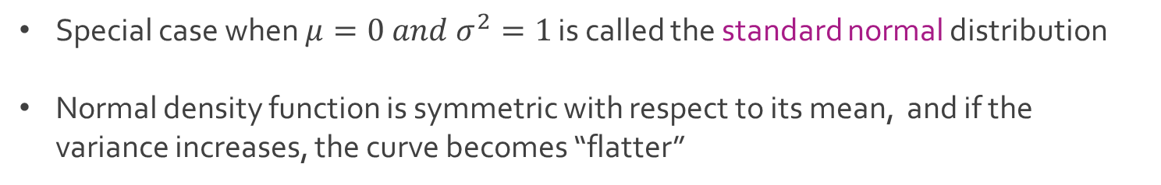
Normal Distribution
Special case when $μ=0 and σ^{2}=1$ is called the standard normal distribution
Normal density function is symmetric with respect to its mean, and if the variance increases, the curve becomes “flatter”

Slide 23
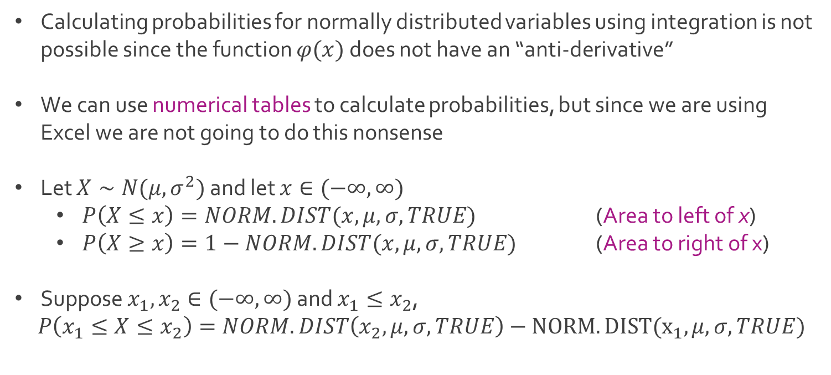
Normal Distribution
Calculating probabilities for normally distributed variables using integration is not possible since the function $φ(x)$ does not have an “anti-derivative”
We can use numerical tables to calculate probabilities, but since we are using Excel we are not going to do this nonsense
Let $X∼N(μ,σ^{2})$ and let $x∈(−∞,∞)$
$P\left(X≤x\right)=NORM.DIST(x,μ,σ,TRUE)$ (Area to left of x)
$P\left(X≥x\right)=1−NORM.DIST(x,μ,σ,TRUE)$ (Area to right of x)
Suppose $x_{1},x_{2}∈(−∞,∞)$ and $x_{1}≤x_{2}$,
$P\left(x_{1}≤X≤x_{2}\right)=NORM.DIST\left(x_{2},μ,σ,TRUE\right)−NORM.DIST(x_{1},μ,σ,TRUE)$

Slide 24
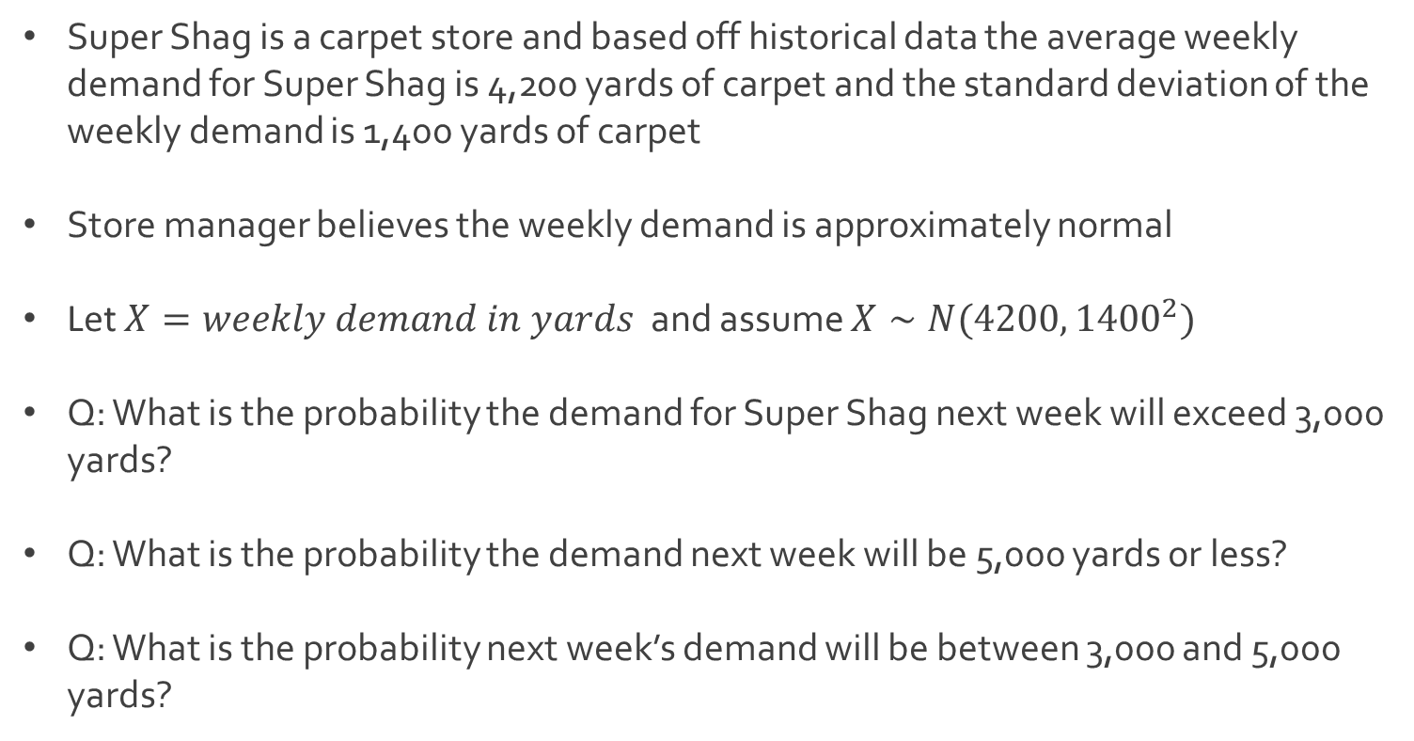
Ex: Carpet Store
Super Shag is a carpet store and based off historical data the average weekly demand for Super Shag is 4,200 yards of carpet and the standard deviation of the weekly demand is 1,400 yards of carpet
Store manager believes the weekly demand is approximately normal
Let $X=weekly demand in yards$ and assume $X∼N(4200, {1400}^{2})$
Q: What is the probability the demand for Super Shag next week will exceed 3,000 yards?
Q: What is the probability the demand next week will be 5,000 yards or less?
Q: What is the probability next week’s demand will be between 3,000 and 5,000 yards?

Slide 25
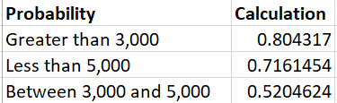

Ex: Carpet Store
Download Shaggy.xlsx from link Sheet 2 on course website
Observe the formulas for the calculation of our 3 probabilities

Slide 26
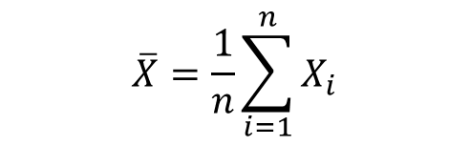
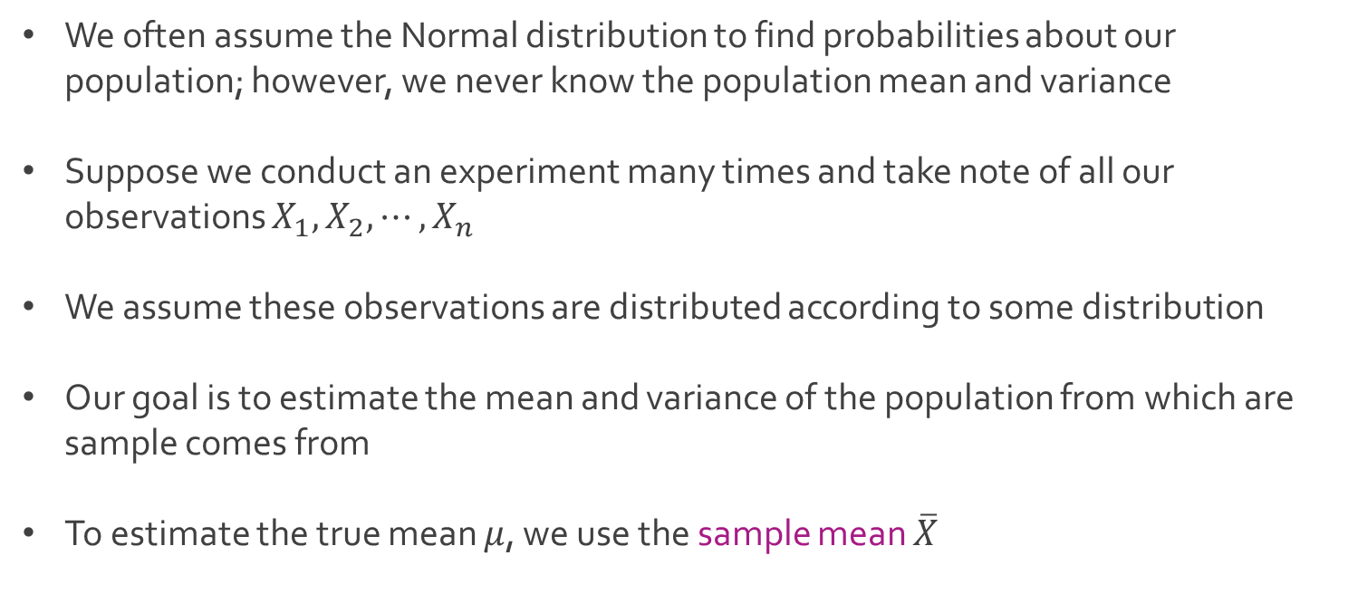
Sample Statistics
We often assume the Normal distribution to find probabilities about our population; however, we never know the population mean and variance
Suppose we conduct an experiment many times and take note of all our observations $X_{1},X_{2},⋯, X_{n}$
We assume these observations are distributed according to some distribution
Our goal is to estimate the mean and variance of the population from which are sample comes from
To estimate the true mean $μ$, we use the sample mean $\overline{X}$
$$\overline{X}=\frac{1}{n}\sum_{i=1}^{n}{X_{i}}$$

Slide 27
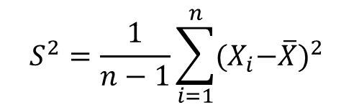
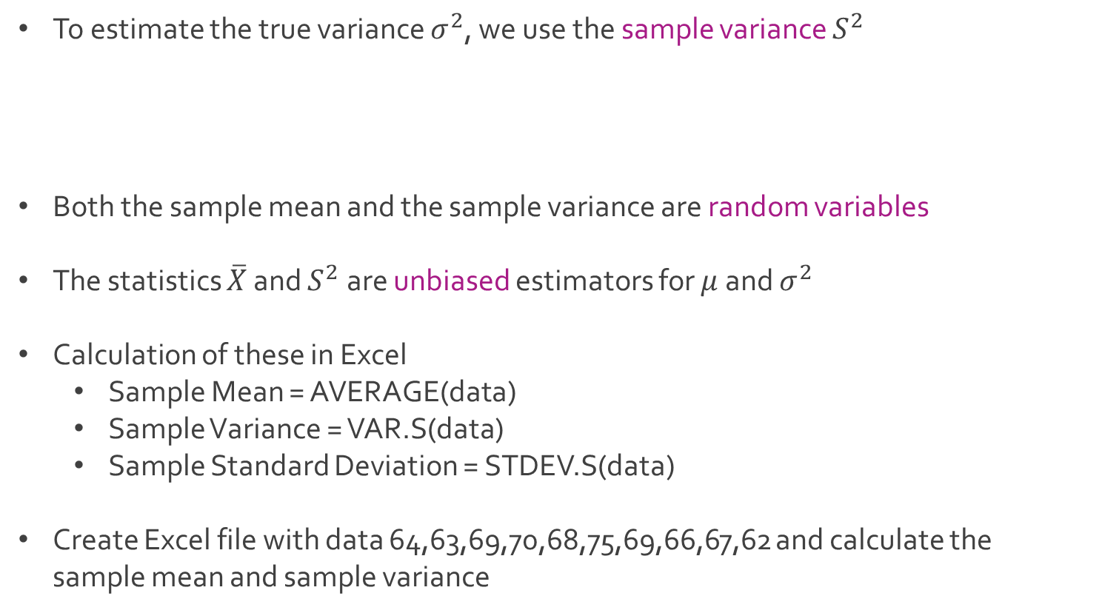
Sample Statistics
To estimate the true variance $σ^{2}$, we use the sample variance $S^{2}$
Both the sample mean and the sample variance are random variables
The statistics $\overline{X}$ and $S^{2}$ are unbiased estimators for $μ$ and $σ^{2}$
Calculation of these in Excel
Sample Mean = AVERAGE(data)
Sample Variance = VAR.S(data)
Sample Standard Deviation = STDEV.S(data)
Create Excel file with data 64,63,69,70,68,75,69,66,67,62 and calculate the sample mean and sample variance
$$S^{2}=\frac{1}{n−1}\sum_{i=1}^{n}{{{(X}_{i}−\overline{X})}^{2}}$$

Slide 28





The End
Dale

